Slide 1

Dr. Ammar Haider
Assistant Professor
School of Computing
CS3002 Information Security
Memory Safety
Vulnerabilities

Slide 2
Memory Safety
“Consider the example of an application that maintains to do lists for many users.
If I have a to do list with ten items, and I ask for the eleventh item, what should happen? […] In a memory unsafe language, unless the programmer explicitly checks which item they’re asking for against the length of the list, the item that happens to be at that position in memory is fetched […]. Allowing programs to read past the front or end of a list is called an out-of-bounds read. […] if we simply allow someone to ask for the eleventh element of a ten item list, they may get to read the first item out of someone else’s list! […]
A closely related spatial vulnerability is an out-of-bounds write. In this case imagine we tried to change the eleventh or negative first item in our to do list. Now we are changing someone else’s to do list.”
https://alexgaynor.net/2019/aug/12/introduction-to-memory-unsafety-for-vps-of-engineering/

Slide 3
Buffer Overflow
Out-of-bounds write is commonly known as buffer overflow.
NIST’s definition:
“A condition at an interface under which more input can be placed into a buffer or data holding area than the capacity allocated, overwriting other information. Attackers exploit such a condition to crash a system or to insert specially crafted code that allows them to gain control of the system.”
https://csrc.nist.gov/glossary/term/buffer_overflow

Slide 4
Buffer Overflow: Basics
Caused by programming error
Allows more data to be stored than capacity available in a fixed sized buffer
buffer can be on stack, heap, global data
Overwriting adjacent memory locations can cause:
corruption of program data
bypass security checks
unexpected transfer of control
memory access violation
execution of code chosen by attacker (control hijacking)

Slide 5
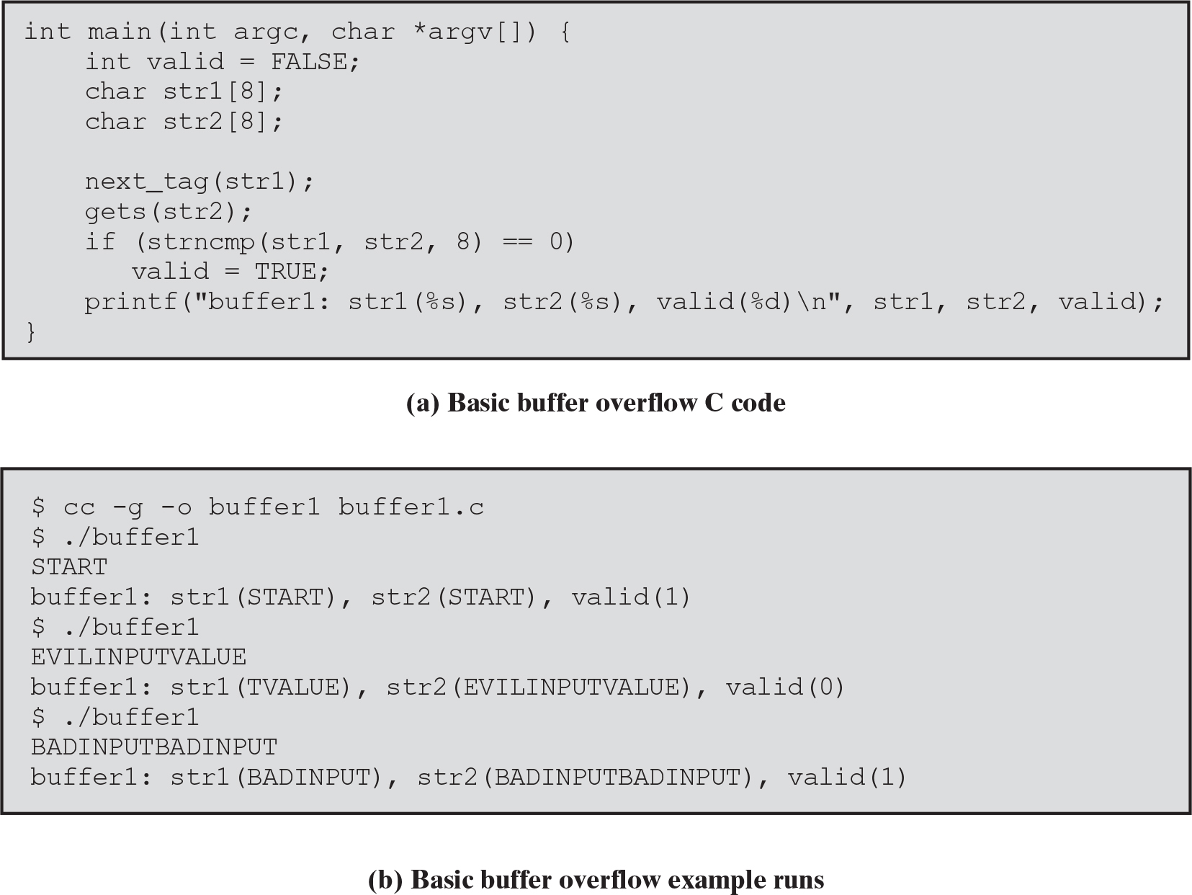
Example
Load a password e.g., “START” into str1
Typical input
Unexpectedly long input
Malicious input

Slide 6
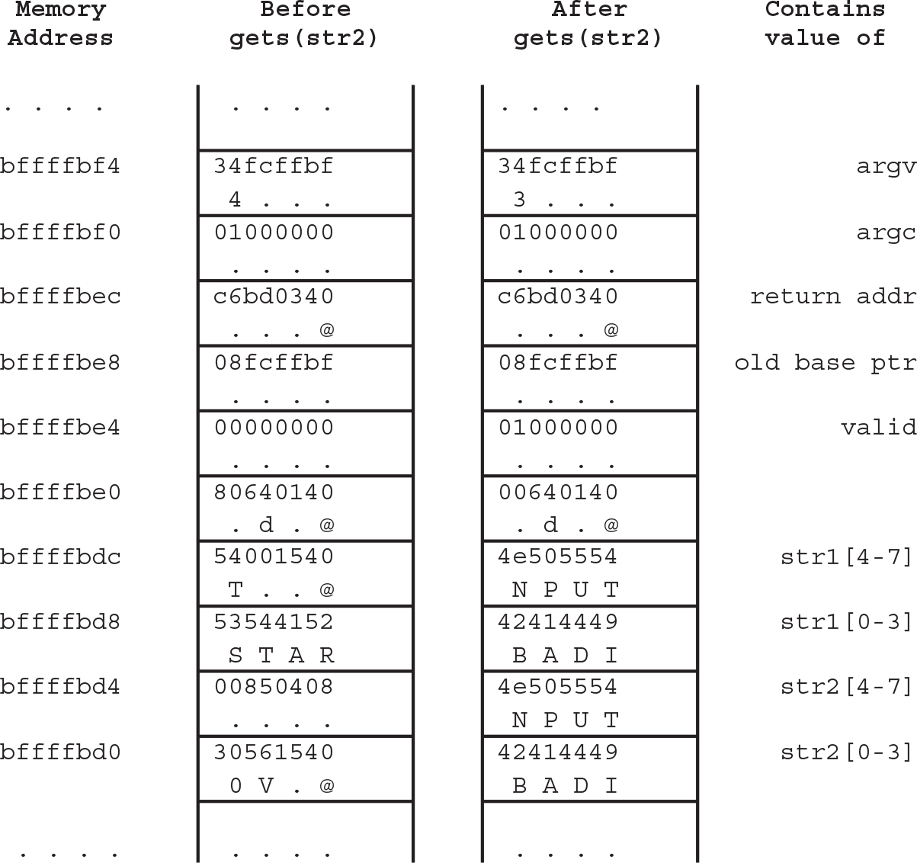
State of Stack
higher addresses
lower addresses
Remember: In general, stack grows backwards (decreasing addresses)

Slide 7
Stack structure during function call
Parameters
Return address
Stack Frame Pointer
Local variables
Stack
Growth
SP

Slide 8
Buffer Overflow Attacks
To exploit a buffer overflow an attacker must identify a buffer overflow vulnerability in some program.
they can do inspection, trace execution, or use fuzzing tools
Next, they need to understand how buffer is stored in memory and determine potential for corruption

Slide 9
Programming languages history
At machine level, all data is an array of bytes
interpretation depends on instructions used
Modern high-level languages (java, c#, python etc.) have a strong notion of data type, valid operations and bounds checking
not vulnerable to buffer overflows
does incur both compile-time and run-time overhead
C and related languages have high-level control structures, but allow direct access to memory
hence are vulnerable to buffer overflow
have a large legacy of widely used, unsafe, and hence vulnerable code

Slide 10
Why use lower level languages
Systems software has historically been written in lower level languages (C, C++, assembly). These include:
operating systems, device drivers, file systems
network servers, database servers
compilers
web browsers
command shells and console utilities
Internet of Things (IoT) firmwares
Why?
Language adds minimal overheads which means faster performance
Raw memory pointers provide more flexibility
* “Systems software” is in contrast with “application software”.

Slide 11
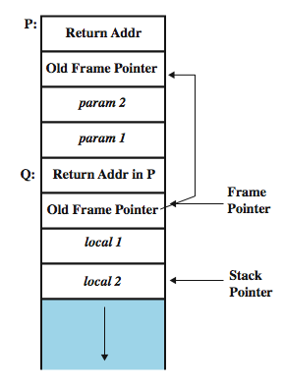
Function calls and stack frames
P function calling Q function
Stack frame
Calling function: needs a data structure to store the “return” address and parameters to be passed
Called function: needs a place to store its local variables somewhere different for every call

Slide 12
Stack Buffer Overflow
Occurs when buffer is located on stack
used by Morris Worm
“Smashing the Stack” paper popularized it
We have local variables below saved frame pointer and return address
hence overflow of a local buffer can potentially overwrite these key control items
Attacker overwrites return address with address of desired code
program, system library or loaded in buffer

Slide 13
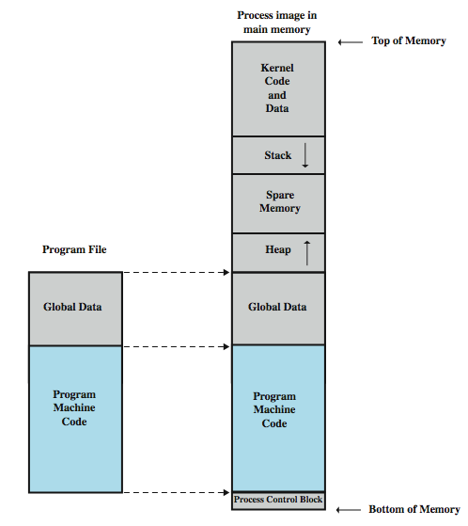
Programs and Processes

Slide 14
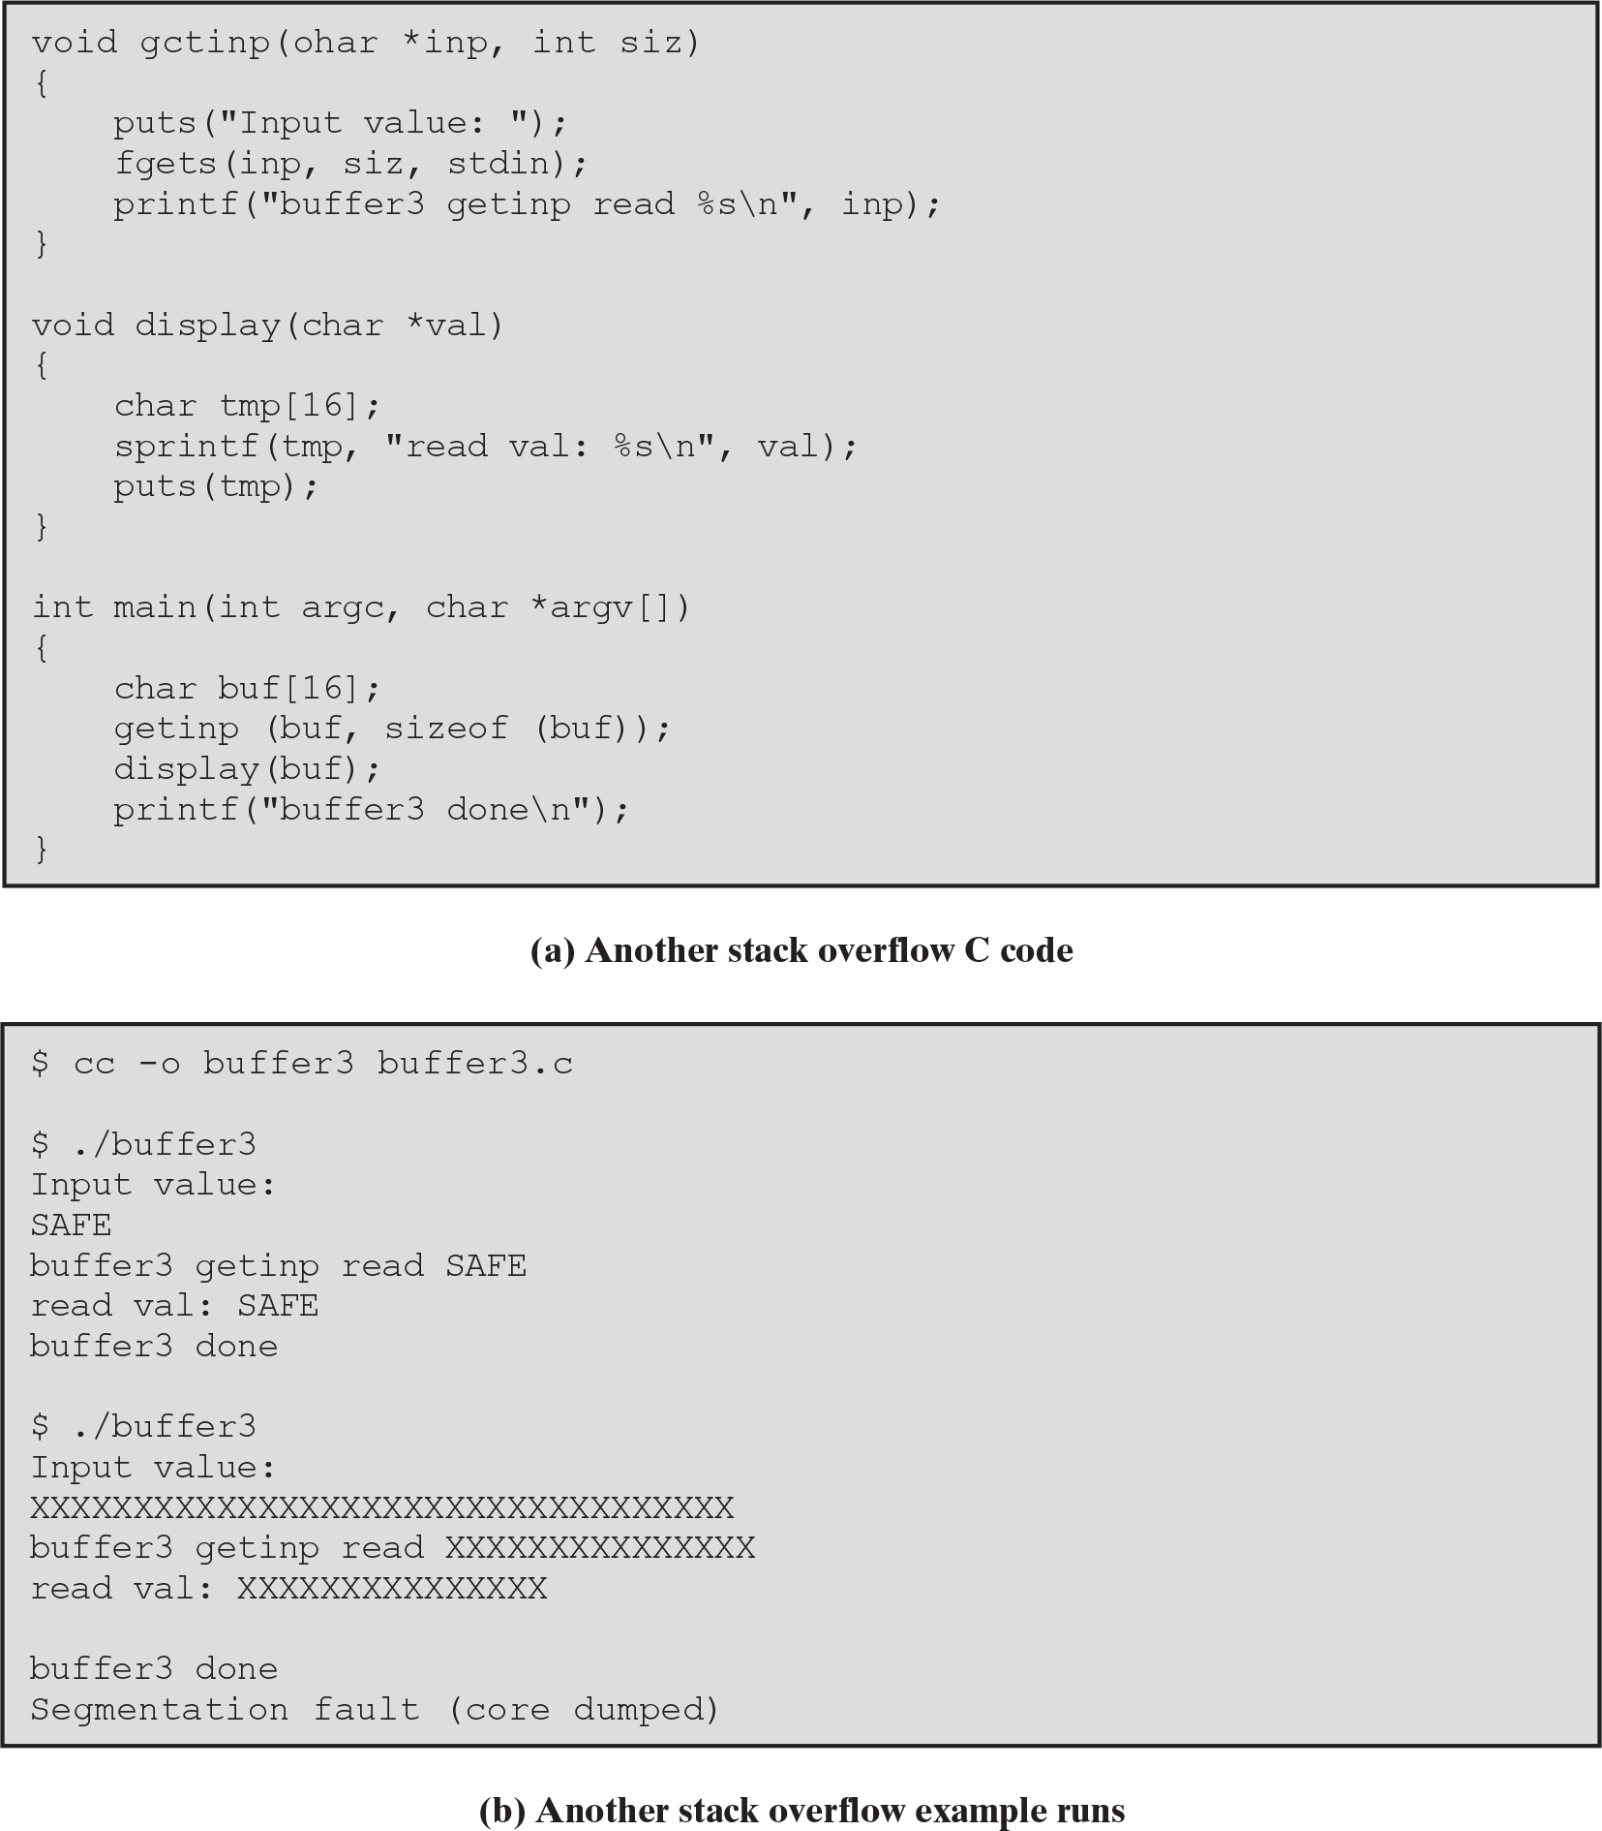
Stack overflow example 2
safe input function
sprintf is unsafe — when preparing a string longer than tmp size, it will overwrite parts of the stack frame.

Slide 15
Stack overflow example 2
Safe input function: reads only 15 characters
Crash because stack frame of display() was partially corrupted

Slide 16
Common unsafe C functions
Commonly used unsafe functions, and their safer alternatives*
❌ gets(char *str) ✔️ fgets(char *str, int n, FILE *stream) | Read line from standard input into str
❌ strcat(char *dest, char *src) ✔️ strncat(char *dest, const char *src, size_t n) | Append contents of string src to string dest
❌ strcpy(char *dest, char *src) ✔️ snprintf or non standard strlcpy | Copy contents of string src to string dest
❌ sprintf(char *str, char *format, ...) ✔️ snprintf(char *str, size, char *format, ...) | Create str according to supplied format
❌ vsprintf(char *str, char *format, va_list arg) ✔️ vsnprintf(char *str, size_t n, char* format, va_list arg) | Create str according to supplied format and variables
Note that even the safe alternatives require programmer to be careful, and pass the correct size value in arguments.

Slide 17
Defenses
Buffer overflows are widely exploited
Large amount of vulnerable code in use
despite cause and countermeasures known
Two broad defense approaches
compile-time
run-time: detect attacks in existing programs
can’t remove vulnerabilities, but make it harder for attacker to exploit them

Slide 18
Compile-Time Defenses
Choice of programming language (for new projects)
Modern high level languages (Rust, Swift, Go etc.) apply strong typing and add additional code for bounds checking
not vulnerable to buffer overflow
compiler enforces permissible operations on variables
runtime checking crashes the programs for out-of-bounds read/write
crashing is not pretty, but safer than undefined behaviour of C
These languages do have higher cost in resource use
…and restrictions on access to hardware
so still need some code in C like languages

Slide 19
Compile-Time Defenses
Safe coding techniques
If using potentially unsafe languages (like C), programmer must explicitly write safe code
by design with new code
extensive code review of existing code, (e.g. OpenBSD)
Buffer overflow safety a subset of general safe coding techniques
Allow for graceful failure (know how things may go wrong)
check for sufficient space in any buffer

Slide 20
Compile-Time Defenses
Language extensions, Safe libraries
Proposals for safety extensions to C: memory range checks added by compiler
performance penalties
must compile programs with special compiler
Several safer standard library variants
new functions, e.g. strlcpy()
safer re-implementation of standard functions as a dynamic library, e.g. Libsafe

Slide 21
Compile-Time Defenses
Stack Protection
Stackgaurd (GCC), Visual C++ /GS flag: add function entry and exit code to check stack for signs of corruption
place a randomly chosen value (canary) between local variables and saved frame pointer
upon function return, check if canary value has changed. Any buffer overflow attempt would overwrite this value first, before modifying frame pointer and return address
abort program if change found
issues: recompilation, debugger support
parameters
return address
frame pointer
canary
locals
parameters
return address
frame pointer
canary
locals
frame1
frame2
stack growth

Slide 22
Compile-Time Defenses
Stack Protection
Alternate method: at function entry, copy the return address in a safe, non-corruptible memory area
upon function exit, check the return address on stack is the same as safe copy
abort the program in case changes are found
format of stack remains unchanged.
This approach is used in gcc extensions Stackshield and Return Address Defender (RAD).

Slide 23
Run-Time Defenses
Non Executable Address Space
aka Data Execution Prevention (DEP)
Many BO attacks copy machine code into some buffer and transfer control to it
Use virtual memory support to mark some regions of memory data-only, and non-executable (to avoid execution of attacker’s code)
e.g. stack, heap, global data
need h/w support in Memory Management Unit (MMU)
Issues: some applications need to put executable code in stack

Slide 24
Run-Time Defenses
Address Space Layout Randomization (ASLR)
Every time a process is created, randomize the location of key data structures in memory
stack, heap, global data: change addresses by 1 MB or so
using random shift for each process
modern systems have large address range, means wasting some has negligible impact
Advantage: attacker can’t predict the location of target buffer (containing the malicious code), so they can’t transfer control to it

Slide 25
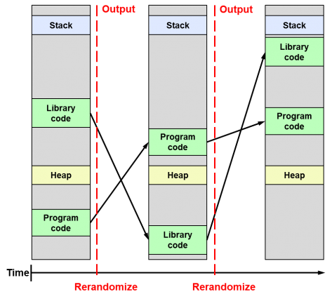
Run-Time Defenses
Address Space Layout Randomization (ASLR)

Slide 26
Run-Time Defenses
Guard Pages
Place guard pages between critical regions of memory (or between stack frames)
flagged in MMU (mem management unit) as illegal addresses
any access aborts process
Can even place between stack frames and heap buffers
at execution time and space cost

Slide 27
Other Overflow Attacks
There is a range of other attack variants
stack overflow variants
heap overflow
global data overflow
format string overflow
integer overflow
more likely to be discovered in future
some cannot be prevented except by coding to prevent originally

Slide 28
Integer Overflow Vulnerabilities

Slide 29
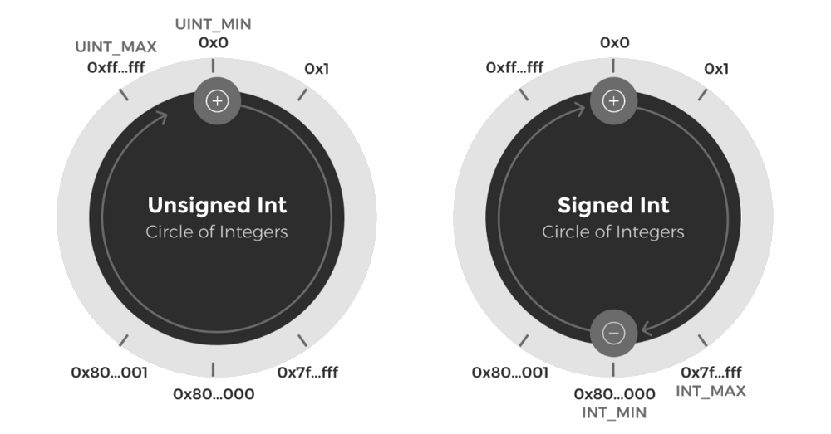
Integer Overflow
An arithmetic operation attempts to create a numeric value that is larger than can be represented within the available storage space.
https://valid.network/post/integer-overflow-in-ethereum

Slide 30
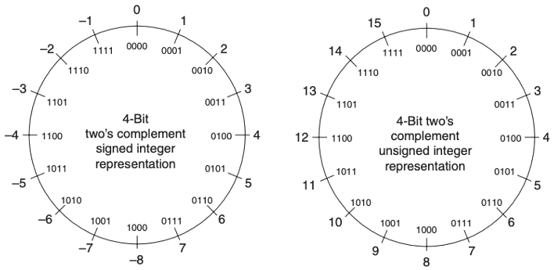
Integer Overflow
Take 4-bit example for simplicity
Add two large unsigned numbers: 13+11
1101 + 1011 = 1 1000
which is 8 (after discarding the carry)
Add two large signed numbers: 5+7
0101 + 0111 = 1100 which is –4
https://medium.com/@ssserpilozdemir/what-is-integer-overflow-716db7d87c04

Slide 31
C/C++ Data Types
char | 8 bits | [0; 255]
short | 16 | [-32,768; 32,767]
unsigned short | 16 | [0; 65,535]
unsigned int | 32 | [0; 4,294,967,295]
int | 32 | [-2,147,483,648; 2,147,483,647]
long | 32 | [-2,147,483,648; 2,147,483,647]
Note: These are typical sizes. Actual sizes may be different, based on platform (cpu architecture) and compiler.

Slide 32
Integer Overflow: Code Example
Overflow as a result of calculations
Test 1:
short x = 30000;
short y = 30000;
printf("%d\n", x+y);
Test 2:
short x = 30000;
short y = 30000;
short z = x + y;
printf("%d\n", z);
Assume short uses 16 bits
Will the two programs output the same?
What will they output?

Slide 33
Integer Overflow: Code Example
Overflow as a result of type casting
uint16_t x; // 16-bit variable uint32_t y = 0x12345678; // 32-bit variable x = (uint16_t) y + 1;
What value does x get?
the truncated value of y (lower 16 bits 0x5678) + 1

Slide 34
Where Does Integer Overflow Matter?
Integer overflows, by themselves, do not allow direct overwriting of memory or hijacking execution flow control, but they indirectly lead to other security vulnerabilities (e.g. buffer overflow).
How? Because overflowed integer could be used for following purposes
Allocating memory (by malloc, calloc etc.)
Calculating indexes into arrays
Checking whether a buffer overflow could occur

Slide 35
Integer Overflow Vulnerabilities
Example
const long MAX_LEN = 20000;
char buf[MAX_LEN];
short len = strlen(input); // [1]
if (len < MAX_LEN) // [2]
strcpy(buf, input);
Can a buffer overflow attack occur?
If so, how long does the input needs to be?
Hints:
1. strcpy parameters are (char *dest, char *src)
2. strlen() returns a number of type size_t (unsigned number)
Notes:
The integer overflow is the root problem, but the (heap) buffer overflow that this enables make it exploitable

Slide 36
Integer Overflow Vulnerabilities
Example
const long MAX_LEN = 20000;
char buf[MAX_LEN];
short len = strlen(input); // [1]
if (len < MAX_LEN) // [2]
strcpy(buf, input);
Range of short is [-32768, 32767]
When the length of input buffer exceeds the max 32767, the condition at [2] evaluates to true.
Note: when input length is between 32768 to 65535, the assignment [1] causes it to be treated as a negative number. When length exceeds 65535, assignment [1] results in truncation.
Notes:
The integer overflow is the root problem, but the (heap) buffer overflow that this enables make it exploitable

Slide 37
Another Example (from Phrack)
int copy_something(char *buf, int len) {
int capacity = 800;
char kbuf[capacity];
if (len > capacity) { // [1]
return -1;
}
return memcpy(kbuf, buf, len); // [2]
}
What could go wrong?
Hints
memcpy expects an unsigned integer as parameter.
Notes:
Attacker may pass in a negative value in len parameter. IF check will pass. memcpy will proceed treating len as (a large) unsigned number

Slide 38
Another Example (from Phrack)
int copy_something(char *buf, int len) {
int capacity = 800;
char kbuf[capacity];
if (len > capacity) { // [1]
return -1;
}
return memcpy(kbuf, buf, len); // [2]
}
What could go wrong?
“By passing a negative value for len argument, it is possible to pass the check at [1], but then in the call to memcpy at [2], len will be interpreted as a huge unsigned value, causing memory to be overwritten well past the end of the buffer kbuf.”
Notes:
Attacker may pass in a negative value in len parameter. IF check will pass. memcpy will proceed treating len as (a large) unsigned number

Slide 39
Integer overflow countermeasures
We can’t stop integer overflow, so we need additional code to either avoid it, or detect it
In some architectures (e.g. x86), CPU itself checks for overflow and sets a flag. The program only needs to check for that flag.
Otherwise manual code should be added for overflow detection, e.g. when calculating sum, if both numbers are positive and sum is negative then report an error. Similarly, if both numbers are negative and sum is positive then report the error.

Slide 40
Format String Vulnerabilities

Slide 41
String formatting in C
String formatting is used by several C functions, like
printf : print to screen
fprintf : print to a file
sprintf : print to a string buffer
Syntax:
Example
printf("format template", arg1, arg2, ...)
printf("a has value %d, b has value %d,
c is at address: %08x\n", a, b, &c);

Slide 42
String formatting in C
Syntax: printf("format template", arg1, arg2, ...)
The format template will contain one or more format specifiers, these control how argN will be encoded for display. e.g.
Optional field width specifier: %4d means output will be made at least four characters wide by prepending spaces (if needed). To prepend zeros instead, use %04d, %08x etc.
%d | Integer (base 10)
%f | Floating point
%s | String
%x | Hexadecimal integer
%n | Output nothing, but count characters printed so far and write that to argN pointer

Slide 43
Malicious format strings: %x
What if args are missing (or not enough)?
printf("format template")
If the format string contains one or more specifiers, printf will expect the args to be present on the stack.
So it will read whatever is on the stack!
What could happen?
Viewing the stack contents
printf("%08x %08x %08x %08x %08x\n");
Output
16d2e5f8 00000000 e9a7ee80 e9cb2560 00000000

Slide 44
Malicious format strings: %s
Typical use case
printf("str has the value %s", str);
// where %s is a string i.e. a char*
What will the following do?
printf("str has the value %s");
It interprets the top of the stack as a pointer (an address) and prints the string located in memory at that address.
Of course, there might not be a string allocated at that address. printf simply prints whatever is in memory up to the next null terminator.
It will either reveal (potentially sensitive) memory contents or crash the program if that address is illegal.

Slide 45
Malicious format strings: %n
%n format specifier behaves differently. Instead of converting an arg to string, it counts the number of characters processed by printf so far, and stores that count to arg pointer.
int j;
printf("how long is this? %n", &j);
Here it will give j the value 18
Consequently,
printf("how long is this? %n");
will interpret the top bytes of the stack as an address X, and then write the number of characters outputted so far to that address!
Notes:
The printf function scans the format string.
It prints the string: "how long is this? ". This is a total of 17 characters (including spaces).
It encounters the %n format specifier.
Because %n requires an additional argument (a pointer to an integer, e.g., int *), printf will look on the stack for that pointer argument.
Since the argument is missing (the command only has one argument: the format string), printf will read the value present at the expected argument's location on the stack and treat that random value as the memory address to which it should write the count (17).

Slide 46
Format string attacks
Leaking data from stack
int main(int argc, char** argv) {
int pincode = 1234;
printf(argv[1]);
}
How can an attacker learn the value of pincode ?
Supplying %x%x%x as input will dump top 12 bytes of the stack

Slide 47
Format string attacks
More serious outcomes
Reading from any address in process memory
Writing to any address in process memory
Requires more investment of time and effort from the attacker
See examples here:
https://web.archive.org/web/20250626121353/https://web.ecs.syr.edu/~wedu/Teaching/cis643/LectureNotes_New/Format_String.pdf

Slide 48
Vulnerable functions
Any function using a format string.
printf family:
printf, fprintf, sprintf, ...
vprintf, vfprintf, vsprintf, ...
Logging:
syslog, err, warn

Slide 49
Countermeasures
Compilers can check if (static) format strings are malformed. e.g. in GCC compiler, the relevant flags are: -Wall, -Wformat, -Wno-format-extra-args, -Wformat-security, -Wformat-nonliteral, -Wformat=2.
Obviously, “these are only useful for detecting bad format strings that are known at compile-time. If the format string may come from the user or from a source external to the application, the application must validate the format string before using it. Care must also be taken if the application generates or selects format strings on the fly.”
Wikipedia

Slide 50
Countermeasures
How do the malicious format strings get injected?
Whenever the format template is dynamic and externally sourced.
Safe
int func(char *user) {
printf("%s", user);
}
Vulnerable
int func(char *user) {
printf(user);
}
Because ‘user’ string could contain anything like %s, %x, %n. Attacker can craft an input string that could let it view or overwrite any location in memory.

Slide 51
References
Stallings SPP chap 10
Why are programs written in C and C++ so frequently vulnerable to overflow attacks? StackExchange Q/A
Format String Vulnerabilities -Explained From the Bottom Up: Medium
https://cs155.stanford.edu/papers/formatstring-1.2.pdf
https://codearcana.com/posts/2013/05/02/introduction-to-format-string-exploits.html

